Slide 1


Analysis of the Mamba, Transformer, and CNN Architectures in the NIH ChestX-Ray14 Dataset
22CSP72 – PROJECT WORK II PHASE I
REVIEW 0
Date : 25.06.2026
Team Members:
22CSR090 - Karunya S
23CSR031 - Bawyasri K
23CSR040 - Deepika M
23CSR043 - Dhanush S
Mentor
Ms. S Kavitha
Assistant professor, SrG
Dept of CSE

Slide 2
Problem Definition
Automatic Chest X-Ray Anomaly detection is an important medical imaging task used to identify multiple thoracic abnormalities such as pneumonia, edema, fibrosis, and cardiomegaly.
Recent studies on the NIH ChestX-ray14 dataset have demonstrated that CNN and Transformer-based architectures achieve superior performance in multi-label chest disease classification.
CNN models effectively capture local image features, while Transformer models excel at learning global contextual relationships, resulting in high diagnostic accuracy.
At the same time, recent research has introduced Mamba State Space Models (SSMs) as a computationally efficient alternative.

Slide 3
Problem Objective
Existing studies indicate that Mamba-based models still underperform compared to CNN and Transformer baselines when detecting complex thoracic abnormalities in chest X-ray images.
The increasing volume of medical imaging data creates a need for efficient and reliable AI-based diagnostic solutions.
Understanding the capabilities of CNN, Transformer, and Mamba architectures is essential for developing next-generation medical imaging systems.
This performance gap highlights the need for a deeper investigation into the strengths and limitations of Mamba architectures for medical image analysis.
https://github.com/bawyasrik31/Reserchproject.git

Slide 4
Research Gap
The dataset contains high-resolution chest X-ray images, requiring models to process large amounts of visual information efficiently.
Significant grayscale intensity variations exist due to differences in imaging conditions, patient positioning, and acquisition settings.
Presence of overlapping anatomical structures (ribs, heart, lungs, clavicles, soft tissues) makes disease localization and feature extraction difficult.
The dataset is weakly supervised, where labels are image-level annotations and may not provide precise disease localization.
There is a lack of comprehensive studies evaluating CNN, Transformer, and Mamba architectures together on weakly supervised chest X-ray datasets.
Addressing this research gap will provide valuable insights into the effectiveness of emerging architectures for medical image analysis.

Slide 5
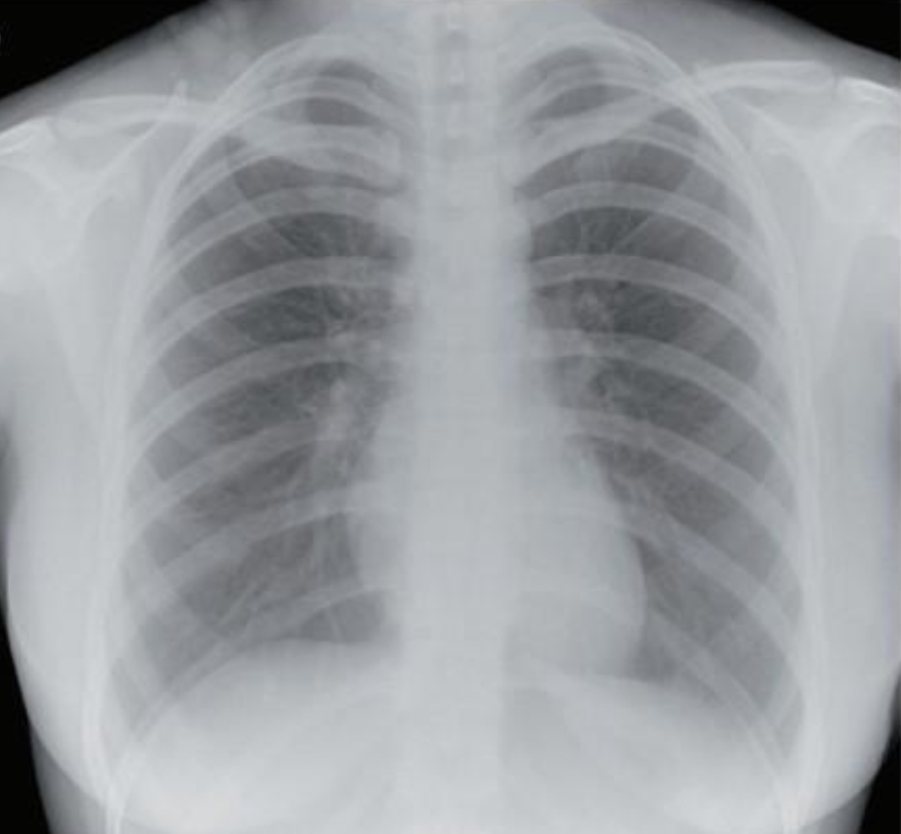
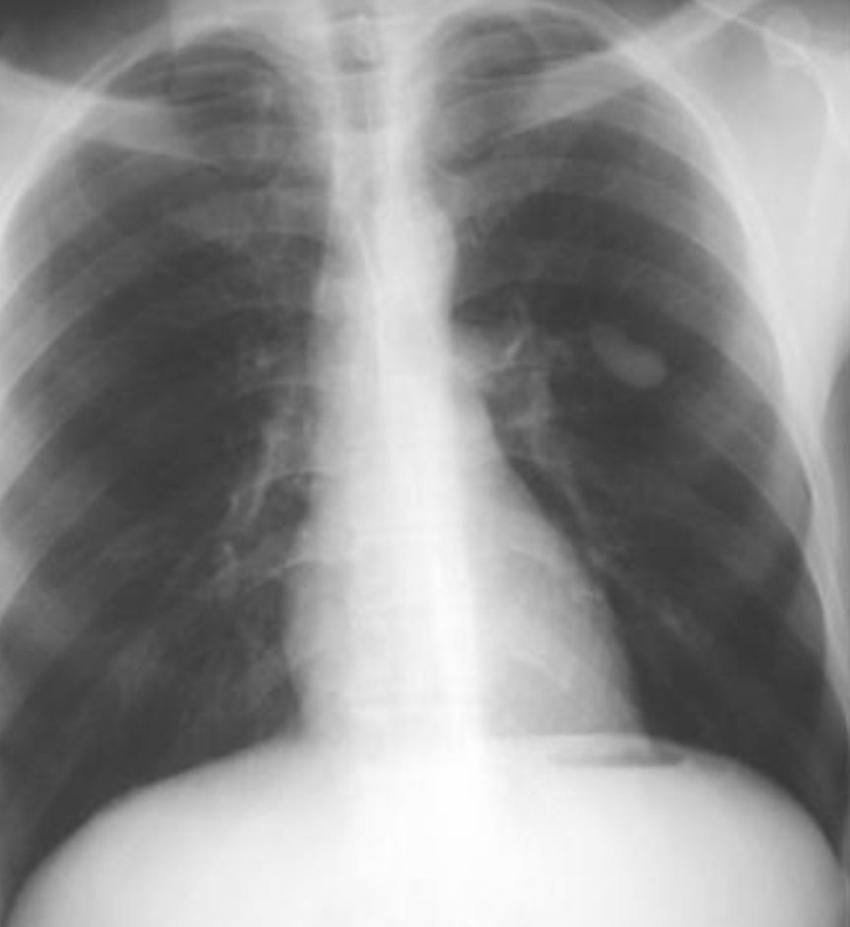
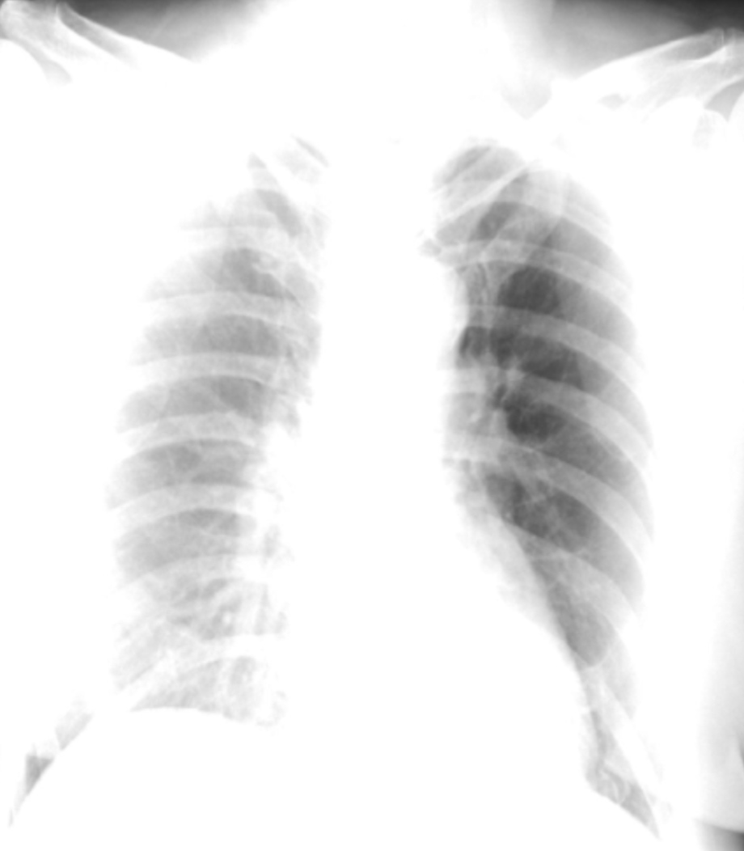
Samples of Chest Radiographs
Overlapping Anatomical Structure
High Resolution Image
Grayscale Variation

Slide 6
Literature Survey
‘ | Paper Title | Author(s) | Methodology Used | Key Takeaway | Result / Findings
1 | Multimodal Masked Siamese Network Improves Chest X-ray Representation Learning | Saeed Shurrab et al. | Self-supervised multimodal learning using a Siamese Network that learns from images and associated information. | Effective feature extraction can be achieved even with limited labeled data. | Best AUROC reported: 0.751 (75.1%).
2 | A Deep-Learning-Based Framework for Identifying and Localizing Multiple Abnormalities and Assessing Cardiomegaly in Chest X-ray | Weijie Fan et al. | CNN-based framework for disease classification and localization. | Provides both disease prediction and localization, improving interpretability. | CTR ICC > 0.95 on test datasets.
3 | Semantically Redundant Training Data Removal and Deep Model Classification Performance | Sivaramakrishnan Rajaraman et al. | Semantic filtering of training data before CNN model training. | Better data quality leads to better classification performance. | Internal test Recall = 0.7164 vs 0.6597; External test Recall = 0.3185 vs 0.2589
4 | BarlowTwins-CXR: Enhancing Chest X-ray Abnormality Localization | Haoyue Sheng et al. | Barlow Twins self-supervised learning framework. | Reduces dependence on costly expert annotations. | Best mAP: 25.02% Improvement: 3% over baseline.
5 | Lightweight Convolutional Neural Network for Chest X-ray Images Classification | Chih-Ta Yen, Chia-Yu Tsao | Lightweight CNN architecture. | Suitable for deployment on systems with limited hardware resources. | Achieved competitive classification accuracy with reduced computational cost.

Slide 7
S.No | Paper Title | Author(s) | Methodology Used | Key Takeaway | Result / Findings
6 | Deep Learning Improves Physician Accuracy in the Comprehensive Detection of Abnormalities on Chest X-rays | Pamela G. Anderson et al. | Deep Learning-based Computer-Aided Diagnosis (CAD) system. | AI can assist radiologists and improve diagnostic accuracy. | AI System AUC: 97.6%. External Validation AUC: 97.5%
7 | A Comparative Analysis of the Mamba, Transformer, and CNN Architectures for Multi-Label Chest X-Ray Anomaly Detection in the NIH ChestX-Ray14 Dataset | Erdem Yanar et al. | Comparative study using DenseNet, EfficientNet, ConvFormer, Swin Transformer, VMamba, and MedMamba. | Transformers achieved the best performance, while Mamba provided computational efficiency but lower accuracy. | ConvFormer Mean AUROC = 0.841 Hernia 94% AUROC, Cardiomegaly 91% AUROC, Edema/Effusion 88% AUROC.
8 | Pretraining Diversity and Clinical Metric Optimization Achieve State-of-the-Art Performance on ChestX-ray14 | George Fisher | Ensemble learning using ConvNeXt models. | Combining multiple pretrained models improves diagnostic performance. | Internal test Recall = 0.7164 vs 0.6597; External test Recall = 0.3185 vs 0.2589
9 | Reproducing and Improving CheXNet: Deep Learning for Chest X-ray Disease Classification | Daniel Strick et al. | Improved training strategies and CheXNet architecture enhancements. | Existing state-of-the-art models can still be improved with better optimization techniques. | Average AUC-ROC: 85% Average F1-Score: 39%
10 | Multi-pathology Chest X-ray Classification with Rejection Mechanisms | Yehudit Aperstein et al. | DenseNet-121 with uncertainty-aware classification and rejection mechanism. | AI systems become more trustworthy when they can identify uncertain cases. | Entropy-based rejection achieved the highest average AUC among tested methods.

Slide 8
Novelty of the Project
Comparative evaluation of CNN, Transformer, and Mamba architectures for chest X-ray disease classification.
Investigation of model performance on:
High-resolution chest X-ray images
Grayscale intensity variations
Overlapping anatomical structures
Weakly supervised disease labels
Inclusion of recent Mamba-based models (VMamba and MedMamba) alongside established CNN and Transformer architectures.
Identification of the most suitable architecture for large-scale chest X-ray disease classification.
To determine the most effective and computationally efficient deep learning architecture for weakly supervised chest X-ray disease classification through a comprehensive comparative study of CNN, Transformer, and Mamba models.

Slide 9
Domain Specifications
CNN Models:
DenseNet121
Reuses features through dense connections, improving information flow and classification performance.
ResNet34
Uses residual connections to enable deep feature learning and reduce training difficulties.
InceptionV3
Extracts features at multiple scales using different filter sizes simultaneously.
EfficientNet-B0
Achieves high accuracy with lower computational cost through optimized network scaling.

Slide 10
Domain Specifications
Transformer Models:
ConvFormer
Combines convolution and self-attention to capture both local and global image features.
CaFormer
Integrates convolution and attention mechanisms for efficient feature extraction.
Swin Transformer
Uses shifted window attention to learn long-range image dependencies efficiently.
DeiT
A data-efficient Transformer that achieves strong performance with reduced training requirements.
Mamba Models:
VMamba
Vision-based Mamba architecture that efficiently captures long-range image features.
MedMamba
Medical imaging-focused Mamba model designed for disease classification tasks.

Slide 11
THANK YOU

